Slide 1
Predicting Customer Satisfaction in the Airline Industry
Team 6 – Joshua Farina (joshuapfarina), Henri Salomon (henri_salomon), Raajitha Middi (Raajitha_Middi), Ryan Chandler (zujin87), Alejandro Martinez (amzeta)
Notes:
My name is Alejandro Martinez from Team 6 and I will be discussing our project on predicting customer satisfaction in the airline industry.

Slide 2
Agenda
Only if we have extra time

Slide 3


Project Overview
Use customer satisfaction survey results to identify the most important factors that lead to customer satisfaction.
Customer satisfaction is a key factor in attracting and retaining business.
By understanding the crucial factors that drive customer satisfaction airlines can allocate resources to optimize business operations.
Notes:
We used a dataset consisting of airline passenger satisfaction survey results to understand which factors are most important to customers and provide recommendations to airlines on how money should be invested or re-allocated to increase customer satisfaction.
Customer satisfaction is a main driver in attracting and retaining business. By finding the most important factors we can provide key insights for airlines to enhance their services, improve the customer experience and optimize business operations in order to differentiate themselves from the competition.
Some estimates indicate that increasing customer retention by as little as 5% increases profits by 25-95%.

Slide 4
Dataset Overview
Notes:
Here is an overview of our dataset which is publicly available on Kaggle. It contains user ratings for multiple aspects of air travel.
Not shown is the target variable which is a binary value for whether the customer was satisfied.

Slide 5
Dataset Overview
Notes:
Our initial hypothesis was that flight distance, inflight wifi service, departure/arrival time convenience, food and drink, seat comfort, inflight entertainment, on-board service, legroom service, inflight service, departure delays in minutes, and arrival delays in minutes would be the most important factors. Additionally, we hypothesized that the relevance of these factors will vary depending on the class, type of travel, demographic factors (e.g., age, gender), and flight distance.

Slide 6
Dataset Overview
Notes:
The variables between the brackets are Likert Scale values, this means that they take an integer value between zero and five with five being the best rating. Zero indicates that the customer did not rate that feature. The remaining values are continuous integer values.
We split the training data into a training and validation set, additionally a separate test set is already provided. The final split is approximately sixty percent training data, twenty percent validation data, and twenty percent test data. The validation data was used for hyperparameter tuning and final model selection and the test data was used to check the final accuracy of the selected model.

Slide 7
Dataset Overview
Notes:
Arrival delay in minutes had 310 missing values and since it is highly correlated with departure delay in minutes we decided to exclude it from our models. There was also a customer id number which we eliminated since it provides no useful information for modeling.
Some of the Likert scale variables had a zero, meaning that they weren’t rated. This accounted for less than 5% of the total data for each variable. We replaced those values with their corresponding mode values calculated on the training data set only. The mode values calculated from the training data set were then used to fill in the zero values on the validation and test set.

Slide 8
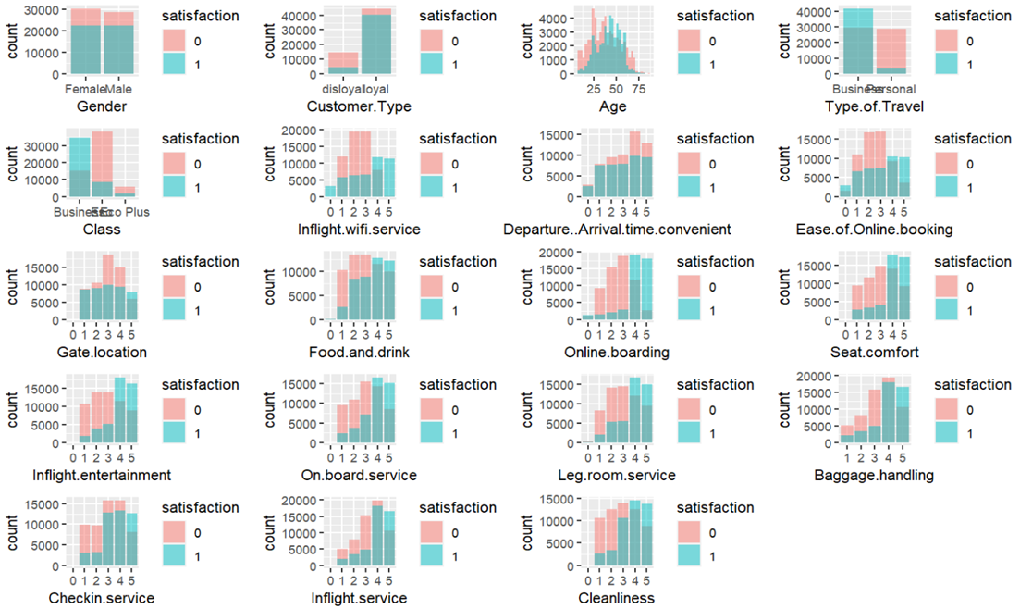
Dataset Overview
Gender doesn’t seem to play a major role in satisfaction as both have almost the same satisfaction levels.
F
M
Notes:
As an initial step in exploratory data analysis we created overlayed graphs for each feature showing the number of satisfied and unsatisfied customers. In this example, we can see that the ratings are very similar for both genders, indicating that gender does not play a major role in satisfaction.

Slide 9
Dataset Overview
Younger travelers are more likely to be dissatisfied
Notes:
Younger travelers are more likely to be dissatisfied, with people in the age group of approximately twenty to thirty five being more dissatisfied than any other age group. Interestingly, people in this age group are more likely to be disloyal.

Slide 10
Dataset Overview
Business class passengers have higher satisfaction levels, particularly in Checkin.service, Seat.Comfort, and Food.and.drink compared to Eco Plus and Economy class
Bus
Eco
Eco+
Notes:
Business class passengers are overwhelmingly more likely to be satisfied whereas economy and economy plus passengers are highly likely to be unsatisfied.

Slide 11
Dataset Overview
Cleanliness does not translate to passenger satisfaction
Notes:
Low cleanliness values of 1 and 2 are highly likely to lead to low satisfaction but once cleanliness is acceptable at 3 or above it does not seem to have a significant effect in creating additional satisfaction.

Slide 12
Dataset Overview
Passengers express greater dissatisfaction with services like Inflight.wifi.service, Inflight.entertainment, Baggage.handling, On.board.service, Inflight.service.
Notes:
Passengers express greater dissatisfaction with services like Inflight.wifi.service, Inflight.entertainment, Baggage.handling, On.board.service, Inflight.service. The ratings for these services need to be above above 3 to increase satisfaction levels and even then it’s approximately a fifty fifty split on whether customers will be satisfied.

Slide 13
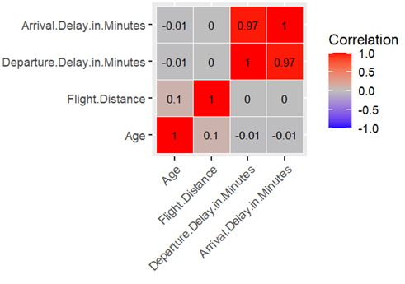
Data Overview
Notes:
We performed different correlation analyses. Shown here are the correlations for the numeric variables. This shows that Arrival.Delay.in.Minutes and Departure.Delay.in.Minutes are highly correlated.

Slide 14
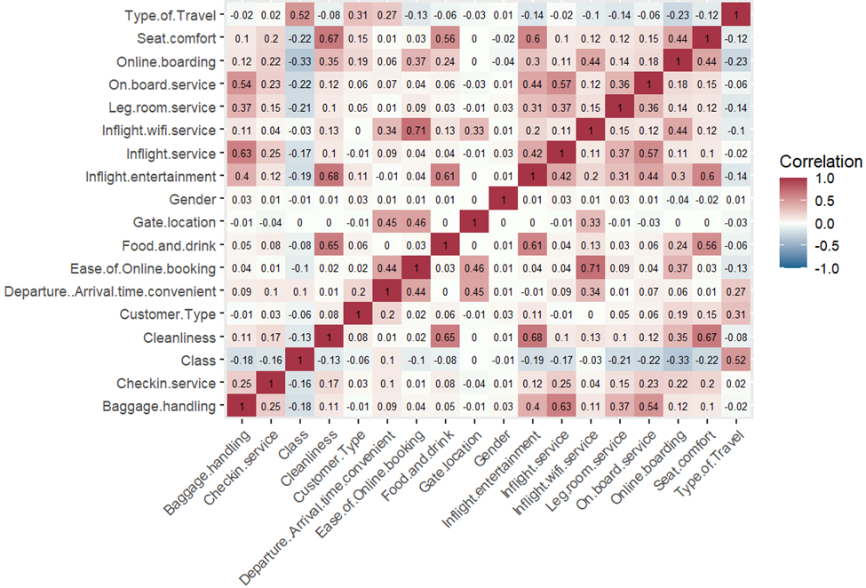
Data Overview
Notes:
Shown here is a heat map for the categorical variables. All the values are less than 0.7 which suggests that there are no strong correlations between any of the variables.

Slide 15
Modeling
Logistic Regression
Decision Tree
Random Forest
Support Vector Machines
Notes:
Departure delay and arrival delay are highly correlated and arrival delay has missing values so we will be excluding arrival delay. ID is removed because it doesn’t provide useful information for modeling.

Slide 16
Sources
https://www.forbes.com/sites/forbesbusinesscouncil/2022/12/12/customer-retention-versus-customer-acquisition/?sh=3cef46fc1c7d
https://www.kaggle.com/datasets/teejmahal20/airline-passenger-satisfaction
https://www.sciencedirect.com/science/article/pii/S0969699723000844#bib20
https://www.sciencedirect.com/science/article/abs/pii/S0969699719302959
https://www.sciencedirect.com/science/article/pii/S2352340923002421
https://psycnet.apa.org/record/1989-10632-001
https://www.techscience.com/cmc/v75n1/51460/pdf

Slide 17
Project Instructions
What is it?
The submission itself will be a video presentation 10-12 minutes in length that explains your entire project.
The video should show your slides (e.g., as pdf/ppt/slides/or similar on your computer screen via screen capture, say using QuickTime, MonoSnap, Screen Recorder etc.) with voice narration; it is up to you whether to show your face. You should be able to create this recording quickly with little effort – no need to do any special video or audio editing although if you feel the need to it is permitted.
It will cover from start to finish all the key highlights and work you’ve done for the past few months. It will also effectively summarize your findings and conclusions.
Imagine that this video would be the result you present to a manager at the culmination of an internal project who may or may not be familiar with all the details and purpose of the project. Take care to explain everything clearly and provide proper background knowledge.
It is alright to assume your audience has some familiarity with statistical models.
What to Include & What is Required?
All group members are required to appear in the presentation both by audio at minimum and preferably by visual as well (however visual is still optional).
Group members should include their names and introduce themselves before speaking
Each group member should be featured for a similar amount of time
Visuals and Slides are necessary; DO NOT just read your final paper/results
Include audio narration
We would like each group member to cover a similar length of the video. Obviously exactly equal time would be impractical to the flow of the presentation but try to keep everyone’s presentation time similar

Slide 18
Project Instructions
Overview of Project:
Team members' names listed in the presentation.
Necessary background information/framing of the problem.
Include an overview of the problem in general as well as your general approach.
State initial hypotheses.
Overview of Data:
How involved was the cleaning process?
What were your key variables?
Any interesting insights from EDA?
If you used feature engineering how and was it successful?
Where did the dataset come from?
Super quick overview of the data.
Overview of Modeling:
What type of models did you use?
How do they compare?
How did you perform model selection?
How did you perform hyperparameter optimization?
How did the models perform generally speaking?
Are they useful and in what ways?
Why did you choose those models in particular?
Include a couple of key visualizations and be sure to include captions, labels, legends, and most importantly context where needed!
If you encounter any unexpected problems, challenges, or interesting findings please mention these. Discussion of things that didn’t work is also encouraged.
Is there any unfinished business or areas which if given more time or resources you would deem promising or interesting to further pursue?
Overall conclusion and key takeaways from your project as a closing message.
Sources cited on the last slide (no need to read them just include them).

